Slide 1
Query Algorithm
CS 5234
Lecture 2

Slide 2

Query Algorithm
We don’t have the time to read the whole data.
We read a small part of the data.
Estimate a statistic of the data.
E.g., Number of one type of element.
The algorithm accesses a small amount of input.
Output based on the limited information we learn.

Slide 3
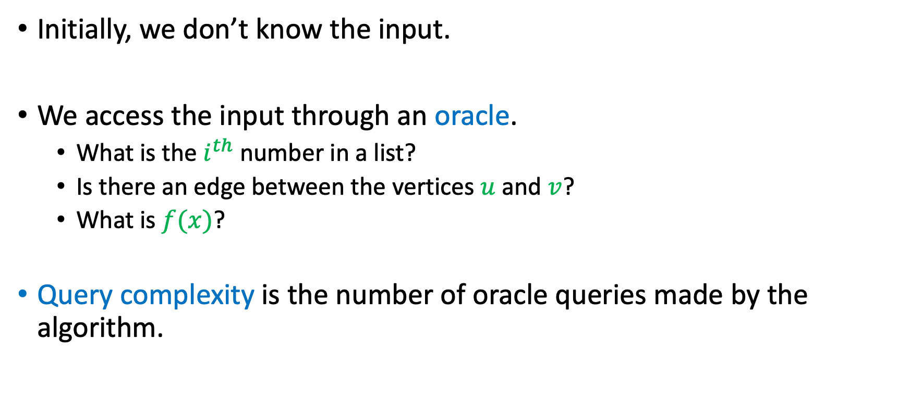
Query Algorithm
Initially, we don’t know the input.
We access the input through an oracle.
What is the $i^{th}$ number in a list?
Is there an edge between the vertices $u$ and $v$?
What is $f(x)$?
Query complexity is the number of oracle queries made by the algorithm.

Slide 4
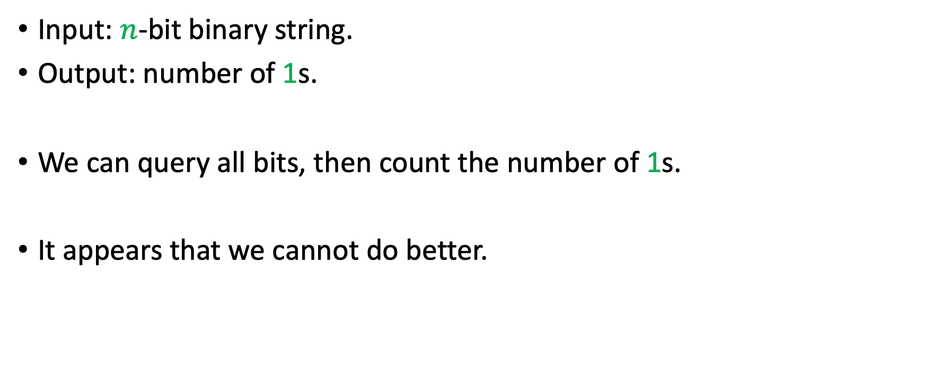
Example: Counting
Input: $n$-bit binary string.
Output: number of 1s.
We can query all bits, then count the number of 1s.
It appears that we cannot do better.

Slide 5
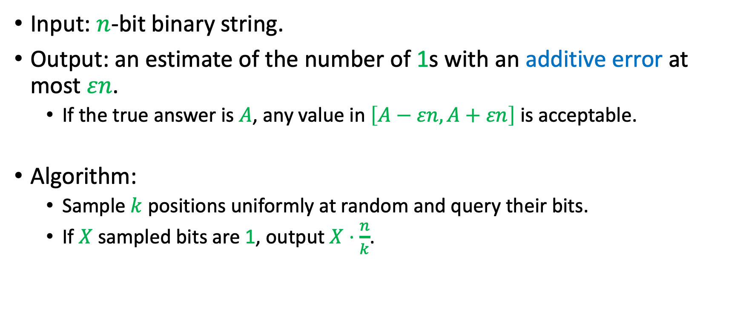
Example: Counting
Input: $n$-bit binary string.
Output: an estimate of the number of 1s with an additive error at most $εn$.
If the true answer is $A$, any value in $\left[A−εn,A+εn\right]$ is acceptable.
Algorithm:
Sample $k$ positions uniformly at random and query their bits.
If $X$ sampled bits are 1, output $X⋅\frac{n}{k}$.

Slide 6
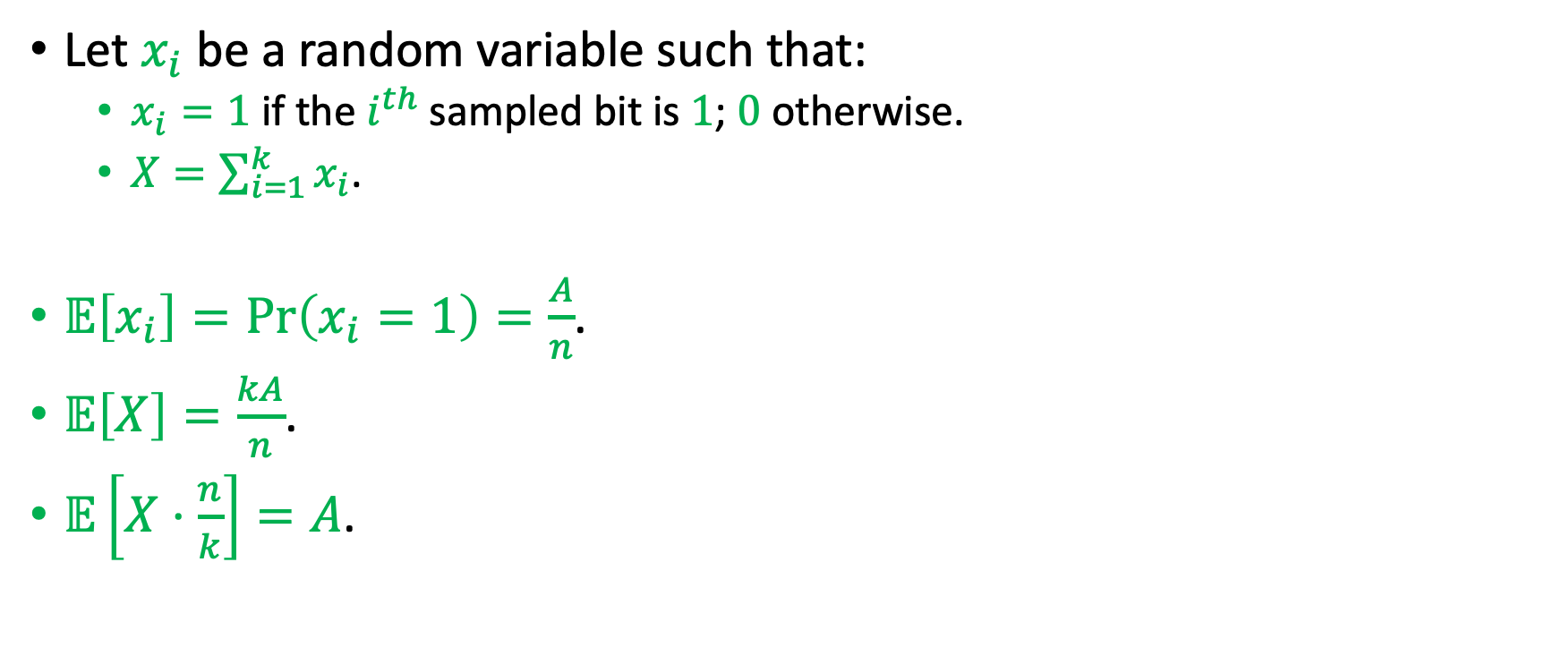
Analysis
Let $x_{i}$ be a random variable such that:
$x_{i}=1$ if the $i^{th}$ sampled bit is $1$; $0$ otherwise.
$X=\sum_{i=1}^{k}{x_{i}}$.
$𝔼\left[x_{i}\right]=\operatorname{Pr}\left(x_{i}=1\right)=\frac{A}{n}$.
$𝔼\left[X\right]=\frac{kA}{n}$.
$𝔼\left[X⋅\frac{n}{k}\right]=A$.

Slide 7
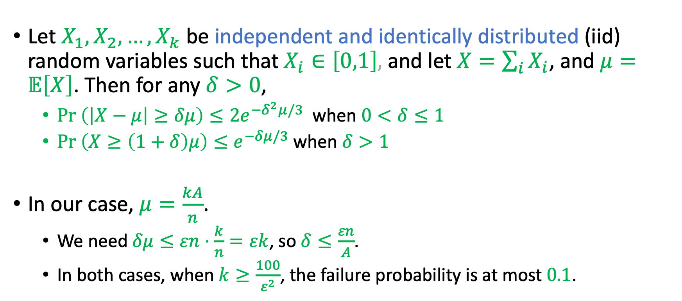
Chernoff Bound
Let $X_{1},X_{2},…,X_{k}$ be independent and identically distributed (iid) random variables such that $X_{i}∈\left[0,1\right],$ and let $X=\sum_{i}{X_{i}}$, and $μ=𝔼\left[X\right]$. Then for any $δ>0$,
$Pr \left(\left|X−μ\right|≥δμ\right)≤2e^{−δ^{2}μ/3}$ when $0<δ≤1$
$Pr \left(X≥\left(1+δ\right)μ\right)≤e^{−δμ/3}$ when $δ>1$
In our case, $μ=\frac{kA}{n}$.
We need $δμ≤εn⋅\frac{k}{n}=εk$, so $δ≤\frac{εn}{A}$.
In both cases, when $k≥\frac{100}{ε^{2}}$, the failure probability is at most $0.1$.

Slide 8
Analyzing Sampling Algorithms
Analyze the expected value of the output.
An estimator is unbiased if its expectation equals the true value.
Show that the output is close to the expectation.
We usually use concentration inequalities such as the Chernoff and Chebyshev bounds.

Slide 9
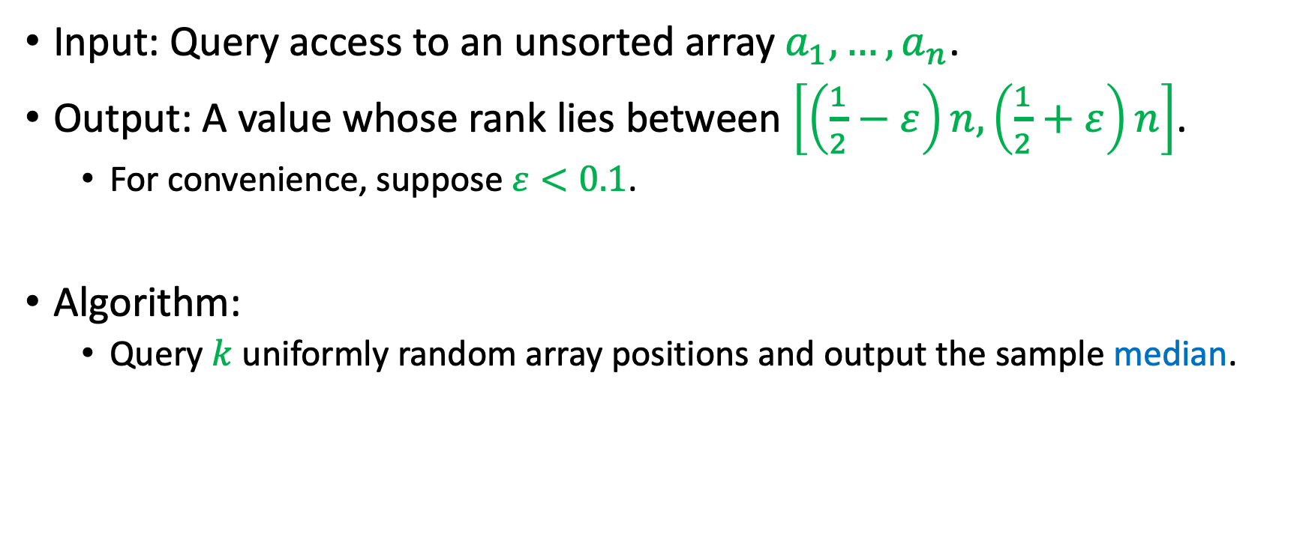
Median Approximation
Input: Query access to an unsorted array $a_{1},…,a_{n}$.
Output: A value whose rank lies between $\left[\left(\frac{1}{2}−ε\right)n,\left(\frac{1}{2}+ε\right)n\right]$.
For convenience, suppose $ε<0.1$.
Algorithm:
Query $k$ uniformly random array positions and output the sample median.

Slide 10
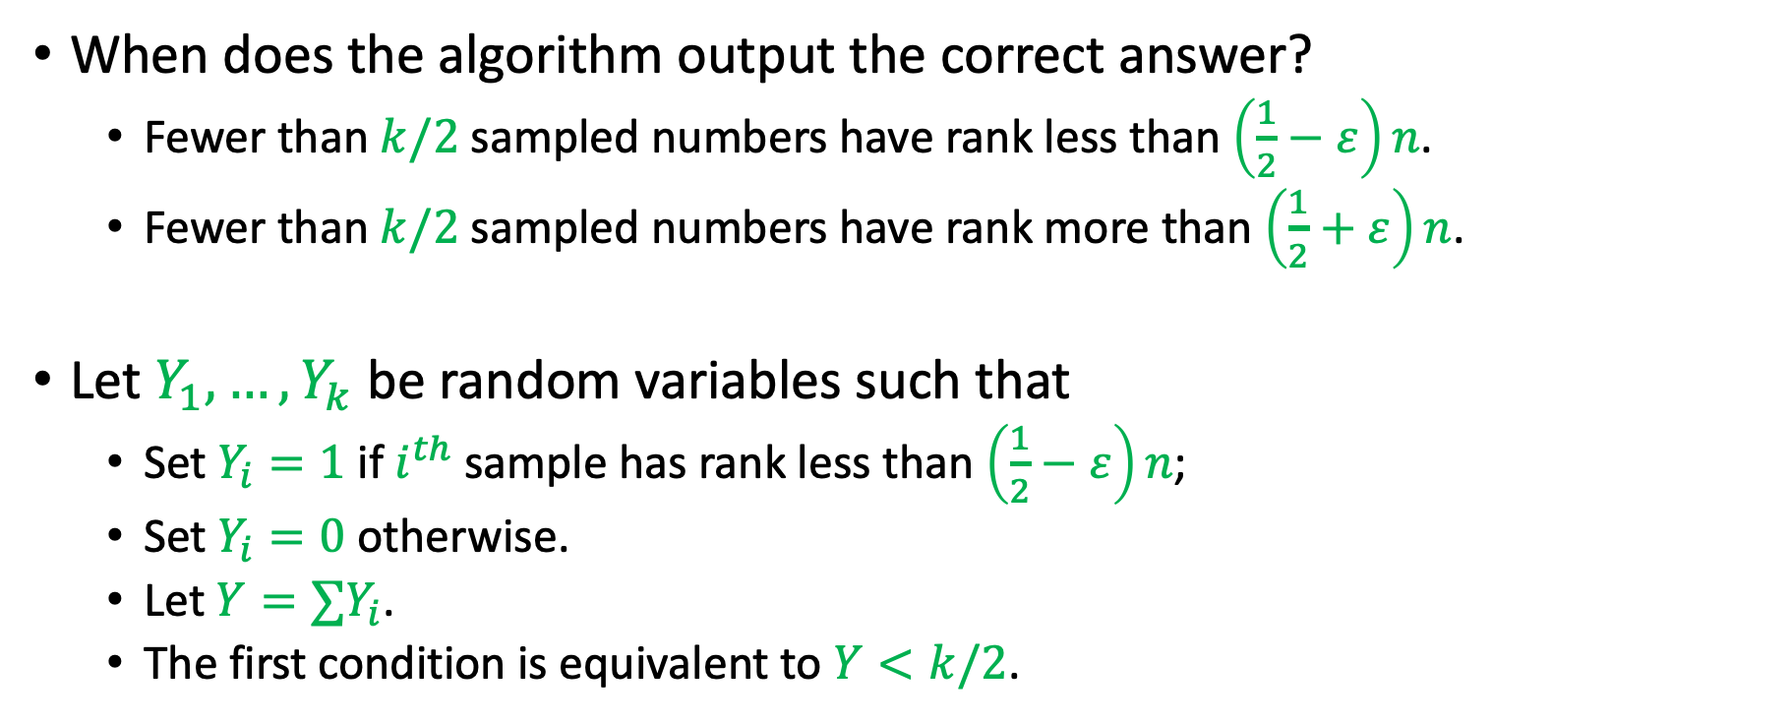
Analysis
When does the algorithm output the correct answer?
Fewer than $k/2$ sampled numbers have rank less than $\left(\frac{1}{2}−ε\right)n$.
Fewer than $k/2$ sampled numbers have rank more than $\left(\frac{1}{2}+ε\right)n$.
Let $Y_{1},…,Y_{k}$ be random variables such that
Set $Y_{i}=1$ if $i^{th}$ sample has rank less than $\left(\frac{1}{2}−ε\right)n$;
Set $Y_{i}=0$ otherwise.
Let $Y=∑Y_{i}$.
The first condition is equivalent to $Y<k/2$.

Slide 11
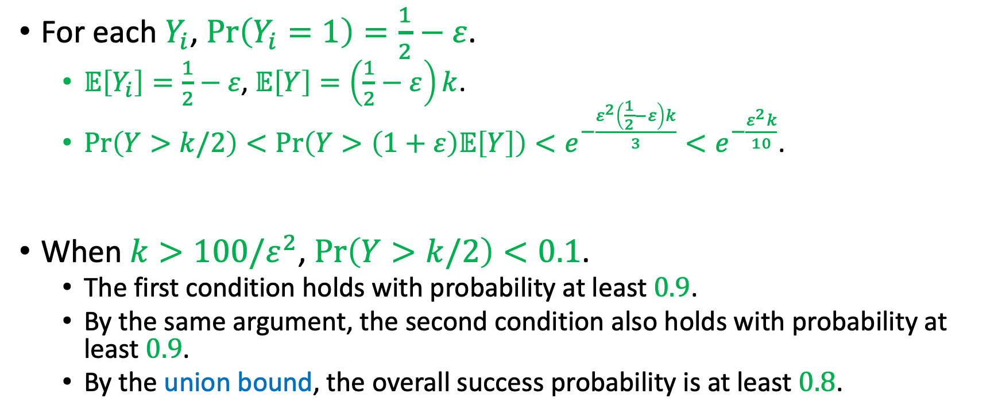
Analysis
For each $Y_{i}$, $\operatorname{Pr}\left(Y_{i}=1\right)=\frac{1}{2}−ε$.
$𝔼\left[Y_{i}\right]=\frac{1}{2}−ε$, $𝔼\left[Y\right]=\left(\frac{1}{2}−ε\right)k$.
$\operatorname{Pr}\left(Y>k/2\right)<\operatorname{Pr}\left(Y>\left(1+ε\right)𝔼\left[Y\right]\right)<e^{−\frac{ε^{2}\left(\frac{1}{2}−ε\right)k}{3}}<e^{−\frac{ε^{2}k}{10}}$.
When $k>100/ε^{2}$, $\operatorname{Pr}\left(Y>k/2\right)<0.1$.
The first condition holds with probability at least $0.9$.
By the same argument, the second condition also holds with probability at least $0.9$.
By the union bound, the overall success probability is at least $0.8$.

Slide 12
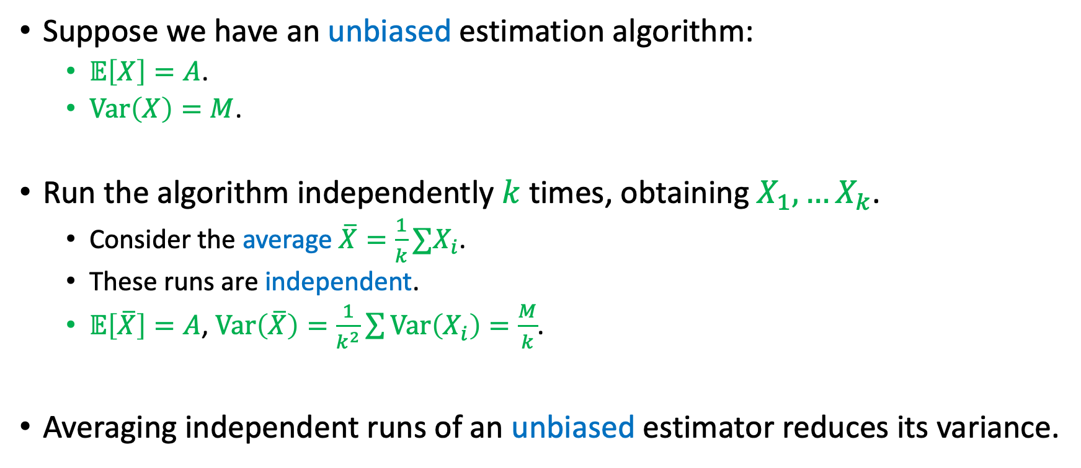
Mean Trick
Suppose we have an unbiased estimation algorithm:
$𝔼\left[X\right]=A$.
$Var\left(X\right)=M$.
Run the algorithm independently $k$ times, obtaining $X_{1},…X_{k}$.
Consider the average $\overline{X}=\frac{1}{k}∑X_{i}$.
These runs are independent.
$𝔼\left[\overline{X}\right]=A$, $Var\left(\overline{X}\right)=\frac{1}{k^{2}}\sum{Var\left(X_{i}\right)}=\frac{M}{k}$.
Averaging independent runs of an unbiased estimator reduces its variance.

Slide 13
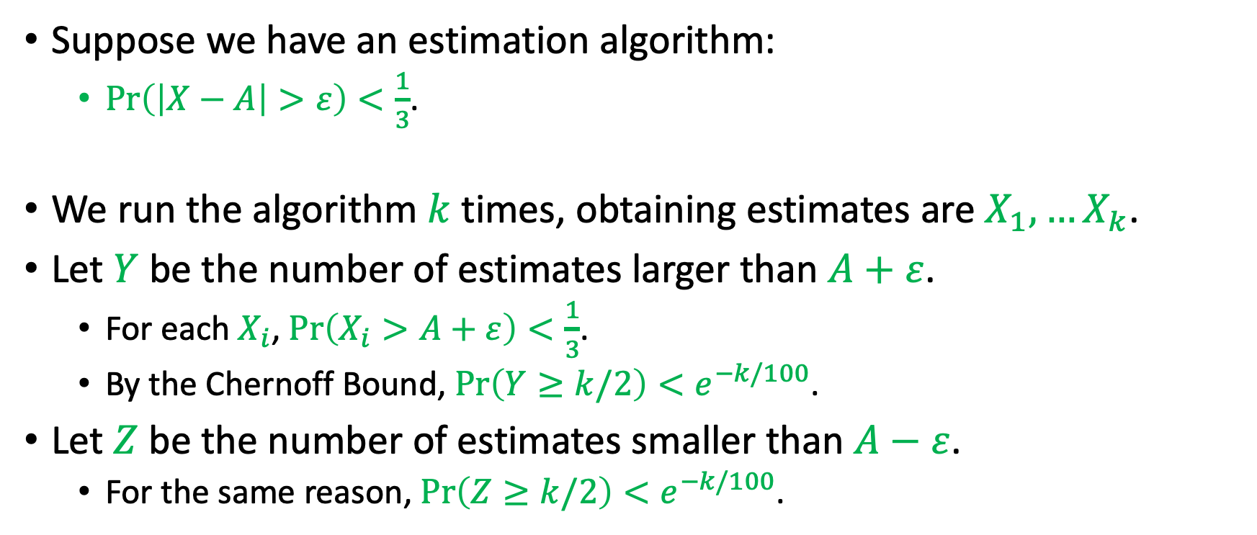
Median Trick
Suppose we have an estimation algorithm:
$\operatorname{Pr}\left(\left|X−A\right|>ε\right)<\frac{1}{3}$.
We run the algorithm $k$ times, obtaining estimates are $X_{1},…X_{k}$.
Let $Y$ be the number of estimates larger than $A+ε$.
For each $X_{i}$, $\operatorname{Pr}\left(X_{i}>A+ε\right)<\frac{1}{3}$.
By the Chernoff Bound, $\operatorname{Pr}\left(Y≥k/2\right)<e^{−k/100}$.
Let $Z$ be the number of estimates smaller than $A−ε$.
For the same reason, $\operatorname{Pr}\left(Z≥k/2\right)<e^{−k/100}$.

Slide 14
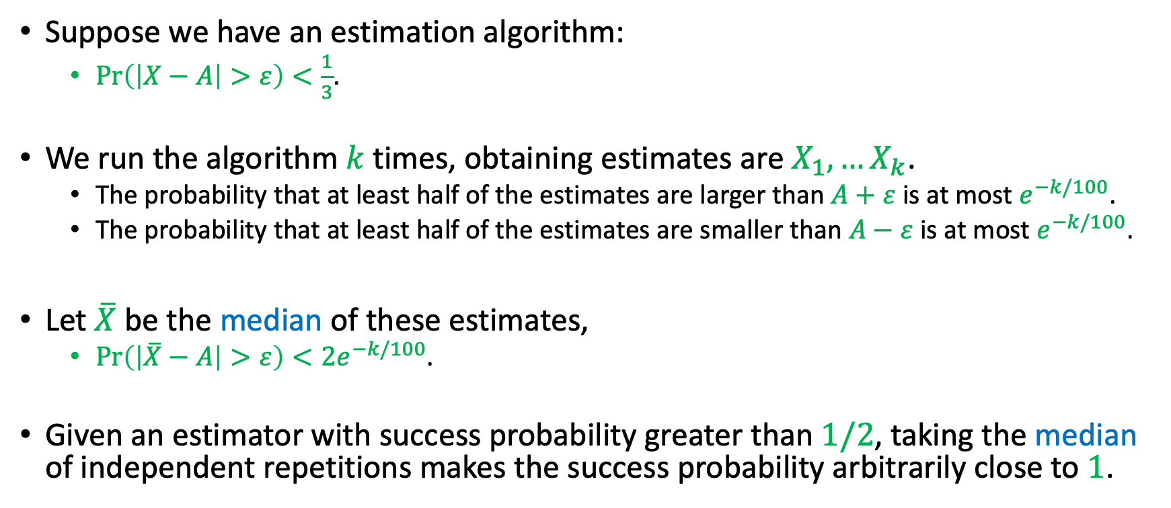
Median Trick
Suppose we have an estimation algorithm:
$\operatorname{Pr}\left(\left|X−A\right|>ε\right)<\frac{1}{3}$.
We run the algorithm $k$ times, obtaining estimates are $X_{1},…X_{k}$.
The probability that at least half of the estimates are larger than $A+ε$ is at most $e^{−k/100}$.
The probability that at least half of the estimates are smaller than $A−ε$ is at most $e^{−k/100}$.
Let $\overline{X}$ be the median of these estimates,
$\operatorname{Pr}\left(\left|\overline{X}−A\right|>ε\right)<2e^{−k/100}$.
Given an estimator with success probability greater than $1/2$, taking the median of independent repetitions makes the success probability arbitrarily close to $1$.

Slide 15
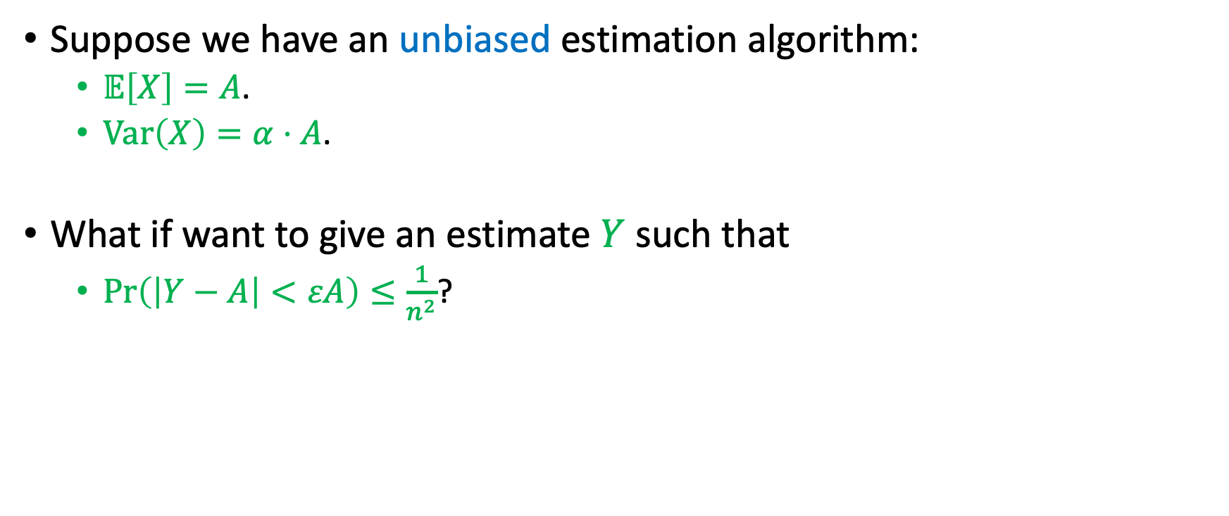
Exercise
Suppose we have an unbiased estimation algorithm:
$𝔼\left[X\right]=A$.
$Var\left(X\right)=α⋅A$.
What if want to give an estimate $Y$ such that
$\operatorname{Pr}\left(\left|Y−A\right|<εA\right)≤\frac{1}{n^{2}}$?

Slide 16
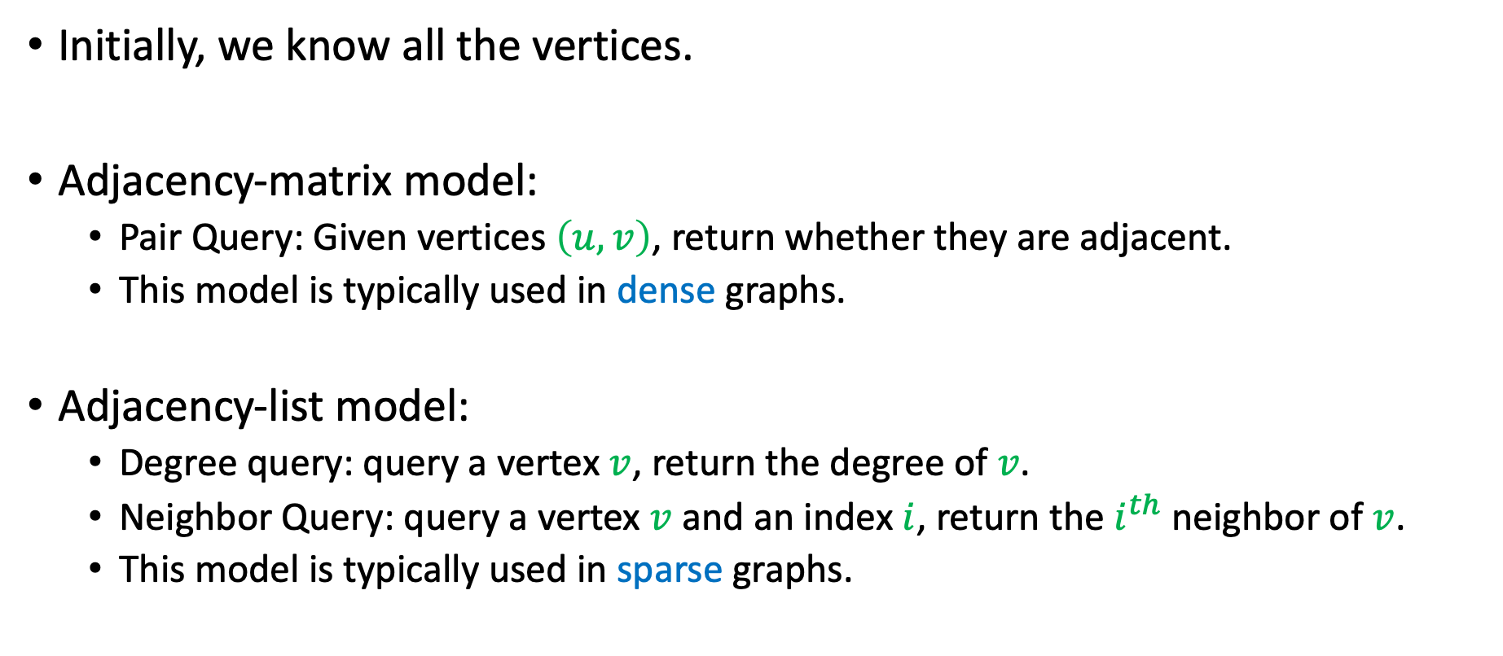
Query Algorithm for Graphs
Initially, we know all the vertices.
Adjacency-matrix model:
Pair Query: Given vertices $\left(u,v\right)$, return whether they are adjacent.
This model is typically used in dense graphs.
Adjacency-list model:
Degree query: query a vertex $v$, return the degree of $v$.
Neighbor Query: query a vertex $v$ and an index $i$, return the $i^{th}$ neighbor of $v$.
This model is typically used in sparse graphs.

Slide 17

Number of Edges
Input: An unweighted graph $G$.
Output: The number of edges $m$.
We consider query algorithms.
$m=\frac{\sum_{v}{d_{v}}}{2}$.
$n$ degree queries are enough.
Can we do better?

Slide 18
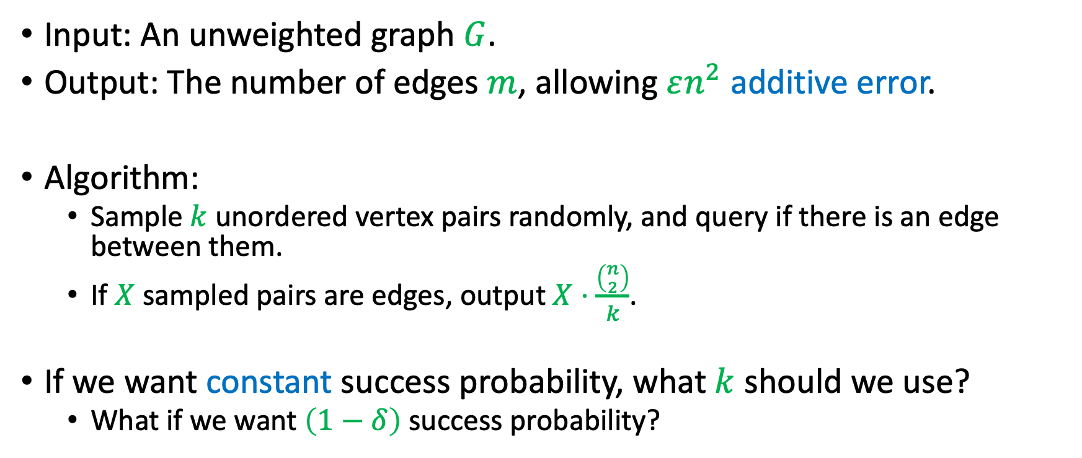
Additive Error
Input: An unweighted graph $G$.
Output: The number of edges $m$, allowing $εn^{2}$ additive error.
Algorithm:
Sample $k$ unordered vertex pairs randomly, and query if there is an edge between them.
If $X$ sampled pairs are edges, output $X⋅\frac{\left({n \atop 2}\right)}{k}$.
If we want constant success probability, what $k$ should we use?
What if we want $\left(1−δ\right)$ success probability?

Slide 19
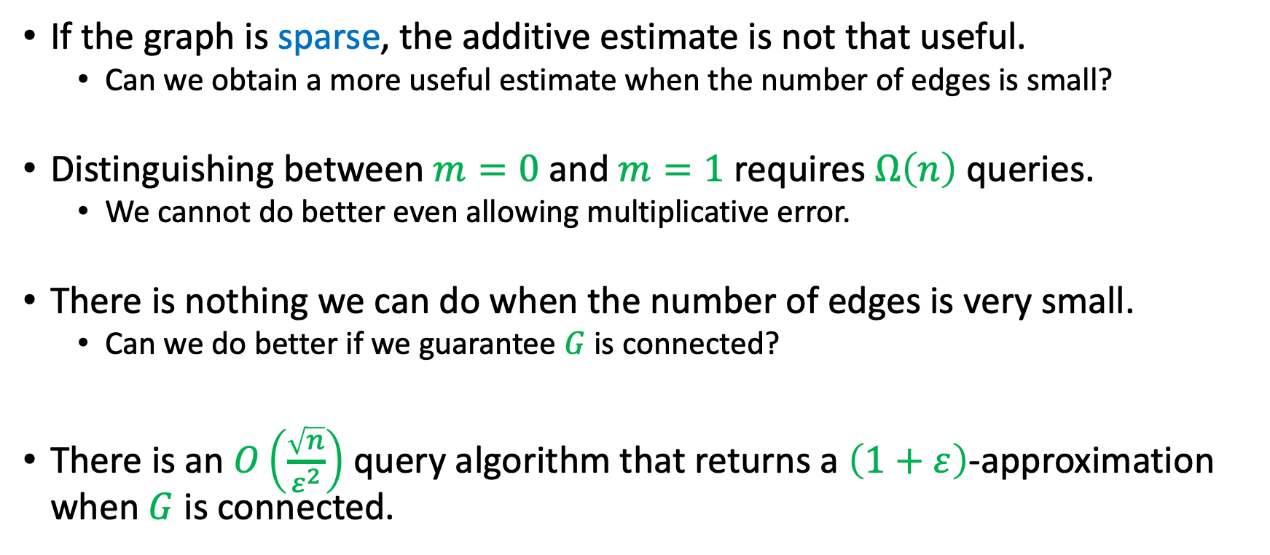
Multiplicative Error
If the graph is sparse, the additive estimate is not that useful.
Can we obtain a more useful estimate when the number of edges is small?
Distinguishing between $m=0$ and $m=1$ requires $Ω\left(n\right)$ queries.
We cannot do better even allowing multiplicative error.
There is nothing we can do when the number of edges is very small.
Can we do better if we guarantee $G$ is connected?
There is an $O\left(\frac{\sqrt{n}}{ε^{2}}\right)$ query algorithm that returns a $\left(1+ε\right)$-approximation when $G$ is connected.

Slide 20
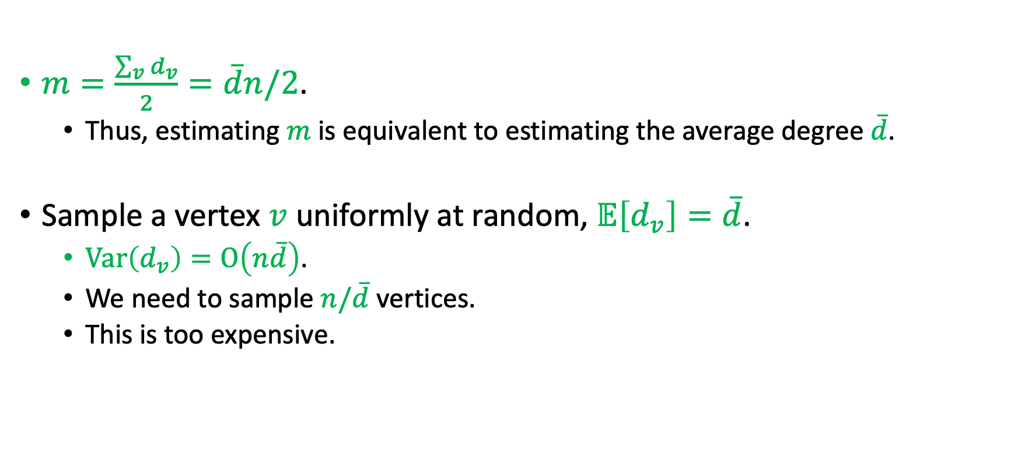
Multiplicative Error
$m=\frac{\sum_{v}{d_{v}}}{2}=\overline{d}n/2$.
Thus, estimating $m$ is equivalent to estimating the average degree $\overline{d}$.
Sample a vertex $v$ uniformly at random, $𝔼\left[d_{v}\right]=\overline{d}$.
$Var\left(d_{v}\right)=O\left(n\overline{d}\right)$.
We need to sample $n/\overline{d}$ vertices.
This is too expensive.

Slide 21
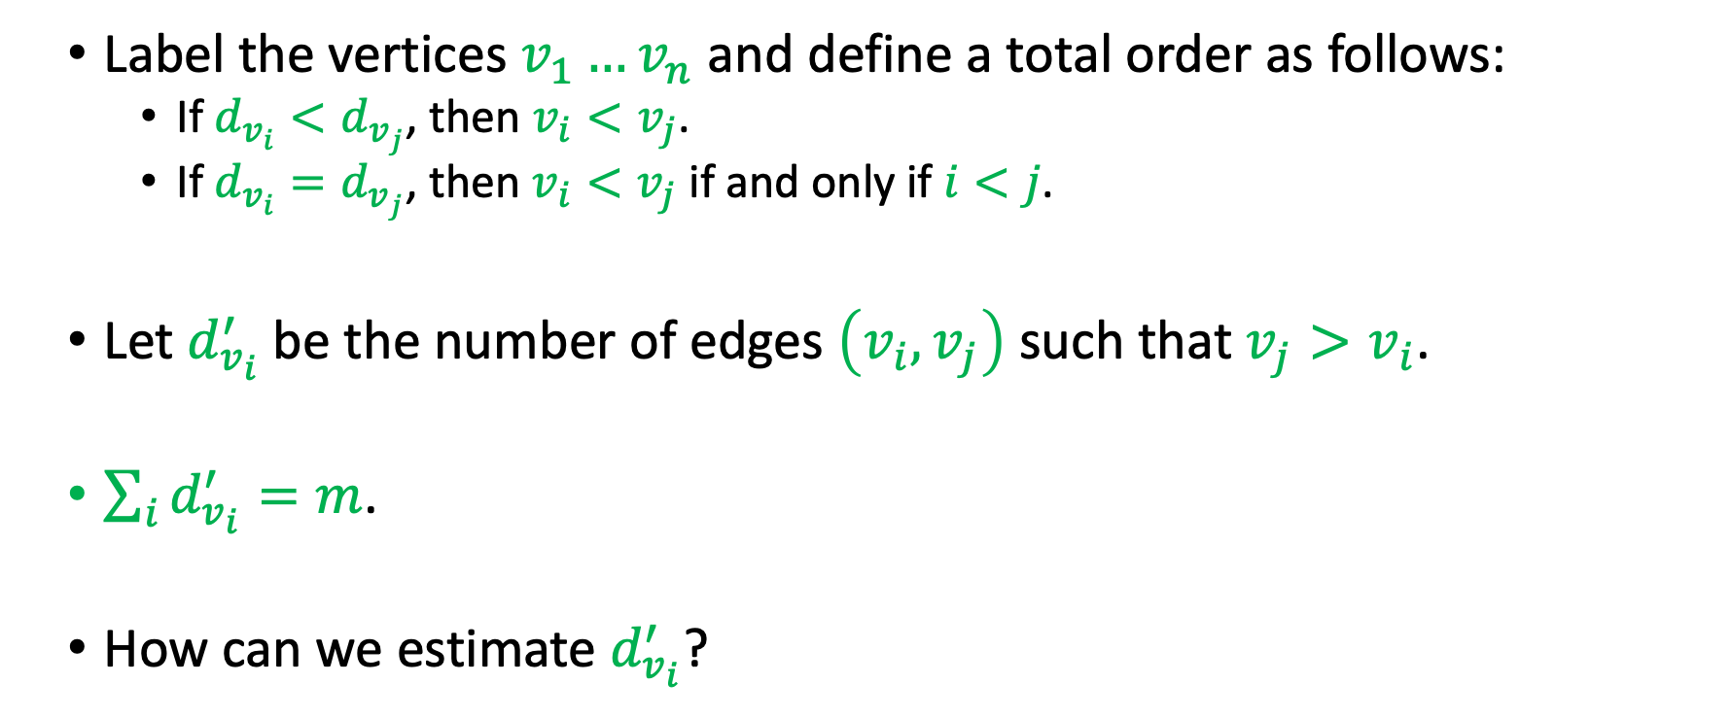
Multiplicative Error
Label the vertices $v_{1}…v_{n}$ and define a total order as follows:
If $d_{v_{i}}<d_{v_{j}}$, then $v_{i}<v_{j}$.
If $d_{v_{i}}=d_{v_{j}}$, then $v_{i}<v_{j}$ if and only if $i<j$.
Let $d_{v_{i}}^{′}$ be the number of edges $\left(v_{i},v_{j}\right)$ such that $v_{j}>v_{i}$.
$\sum_{i}{d_{v_{i}}^{′}}=m$.
How can we estimate $d_{v_{i}}^{′}$?

Slide 22
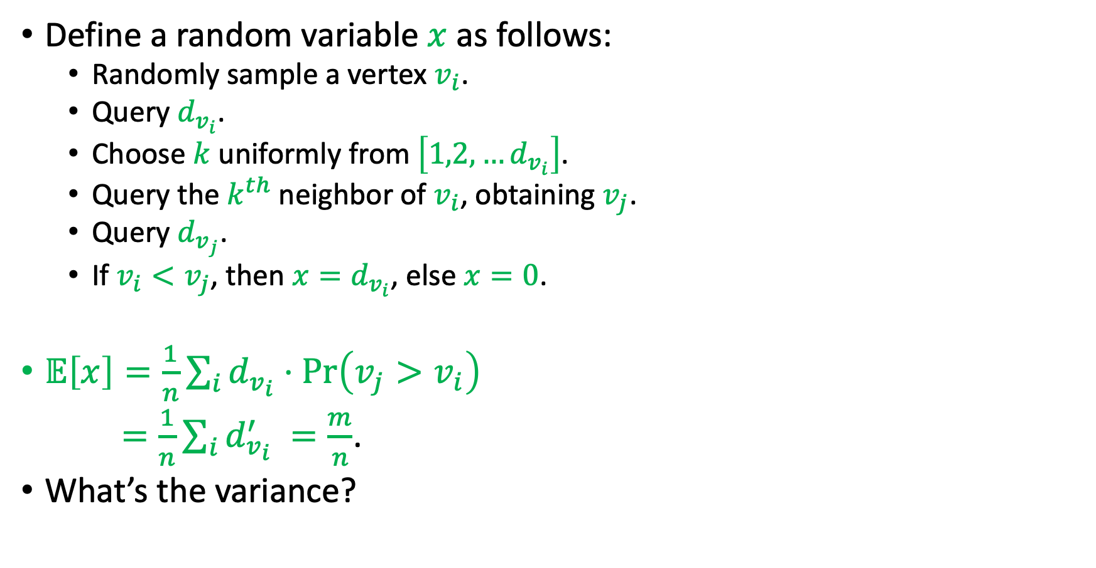
Multiplicative Error
Define a random variable $x$ as follows:
Randomly sample a vertex $v_{i}$.
Query $d_{v_{i}}$.
Choose $k$ uniformly from $\left[1,2,…d_{v_{i}}\right]$.
Query the $k^{th}$ neighbor of $v_{i}$, obtaining $v_{j}$.
Query $d_{v_{j}}$.
If $v_{i}<v_{j}$, then $x=d_{v_{i}}$, else $x=0$.
$𝔼\left[x\right]=\frac{1}{n}\sum_{i}{d_{v_{i}}⋅\operatorname{Pr}\left(v_{j}>v_{i}\right)}$
$=\frac{1}{n}\sum_{i}{d_{v_{i}}^{′} }=\frac{m}{n}$.
What’s the variance?

Slide 23
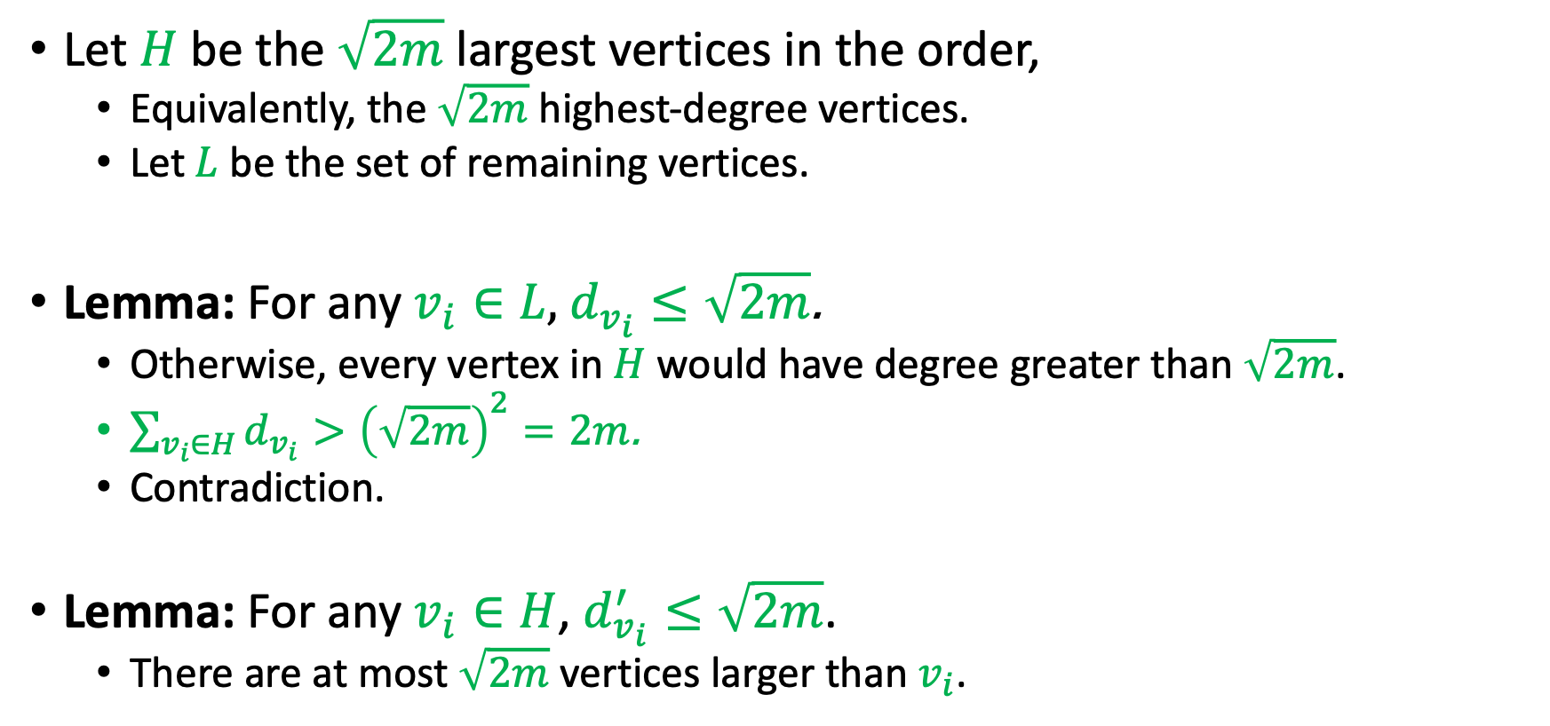
Multiplicative Error
Let $H$ be the $\sqrt{2m}$ largest vertices in the order,
Equivalently, the $\sqrt{2m}$ highest-degree vertices.
Let $L$ be the set of remaining vertices.
Lemma: For any $v_{i}∈L$, $d_{v_{i}}≤\sqrt{2m}$.
Otherwise, every vertex in $H$ would have degree greater than $\sqrt{2m}$.
$\sum_{v_{i}∈H}{d_{v_{i}}}>{\left(\sqrt{2m}\right)}^{2}=2m$.
Contradiction.
Lemma: For any $v_{i}∈H$, $d_{v_{i}}^{′}≤\sqrt{2m}$.
There are at most $\sqrt{2m}$ vertices larger than $v_{i}$.

Slide 24
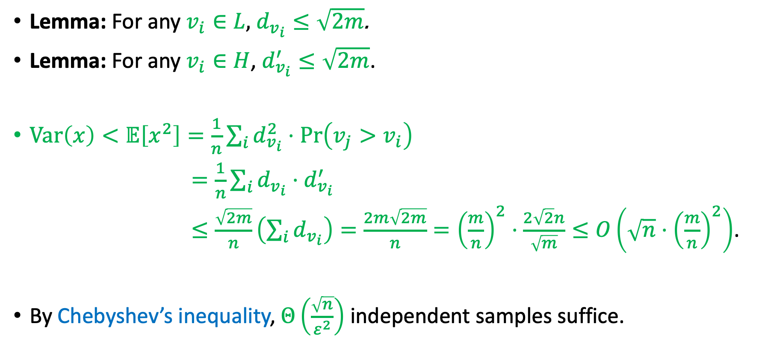
Multiplicative Error
Lemma: For any $v_{i}∈L$, $d_{v_{i}}≤\sqrt{2m}$.
Lemma: For any $v_{i}∈H$, $d_{v_{i}}^{′}≤\sqrt{2m}$.
$Var\left(x\right)<𝔼\left[x^{2}\right]=\frac{1}{n}\sum_{i}{d_{v_{i}}^{2}⋅\operatorname{Pr}\left(v_{j}>v_{i}\right)}$
$=\frac{1}{n}\sum_{i}{d_{v_{i}}⋅d_{v_{i}}^{′} }$
$≤\frac{\sqrt{2m}}{n}\left(\sum_{i}{d_{v_{i}}}\right)=\frac{2m\sqrt{2m}}{n}={\left(\frac{m}{n}\right)}^{2}⋅\frac{2\sqrt{2}n}{\sqrt{m}}≤O\left(\sqrt{n}⋅{\left(\frac{m}{n}\right)}^{2}\right)$.
By Chebyshev’s inequality, $Θ\left(\frac{\sqrt{n}}{ε^{2}}\right)$ independent samples suffice.

Slide 25
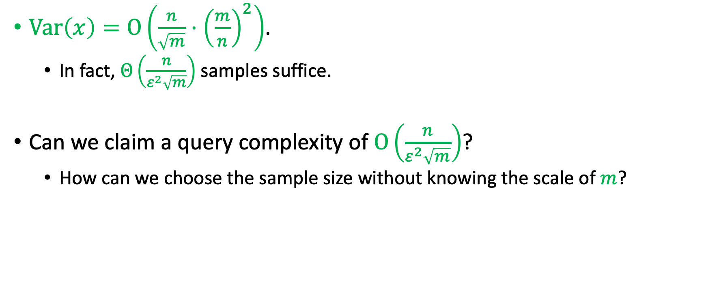
A Density-Sensitive Query Bound
$Var\left(x\right)=O\left(\frac{n}{\sqrt{m}}⋅{\left(\frac{m}{n}\right)}^{2}\right)$.
In fact, $Θ\left(\frac{n}{ε^{2}\sqrt{m}}\right)$ samples suffice.
Can we claim a query complexity of $O\left(\frac{n}{ε^{2}\sqrt{m}}\right)$?
How can we choose the sample size without knowing the scale of $m$?

Slide 26
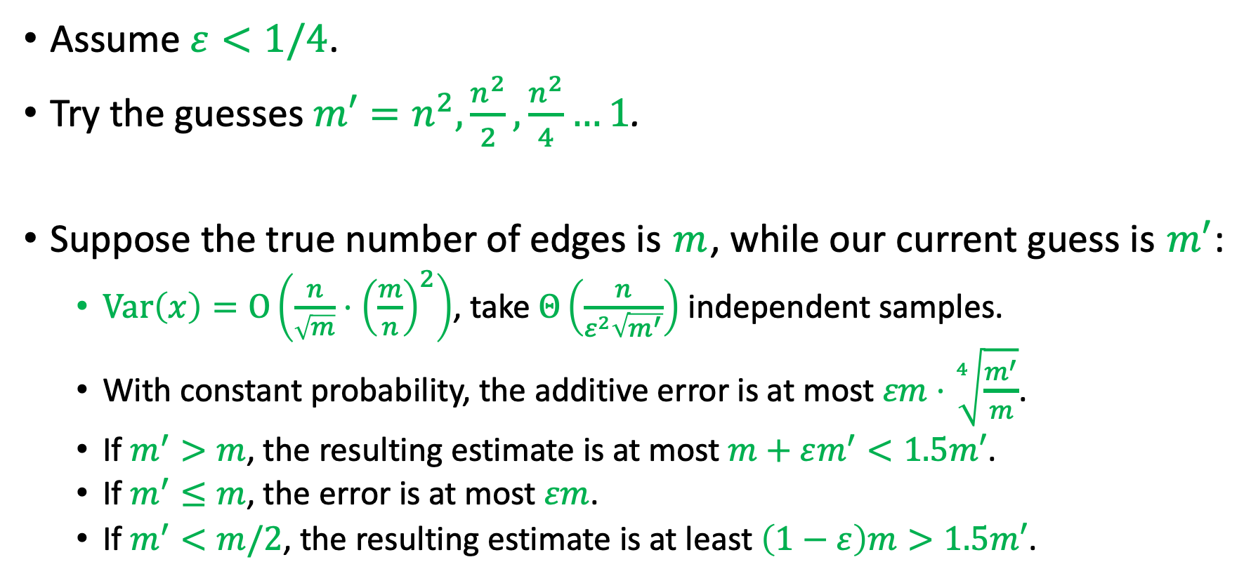
Guessing the Number of Edges
Assume $ε<1/4$.
Try the guesses $m′=n^{2},\frac{n^{2}}{2},\frac{n^{2}}{4}…1$.
Suppose the true number of edges is $m$, while our current guess is $m′$:
$Var\left(x\right)=O\left(\frac{n}{\sqrt{m}}⋅{\left(\frac{m}{n}\right)}^{2}\right)$, take $Θ\left(\frac{n}{ε^{2}\sqrt{m^{′}}}\right)$ independent samples.
With constant probability, the additive error is at most $εm⋅\sqrt[4]{\frac{m^{′}}{m}}$.
If $m^{′}>m$, the resulting estimate is at most $m+εm^{′}<1.5m′$.
If $m^{′}≤m$, the error is at most $εm$.
If $m^{′}<m/2$, the resulting estimate is at least $\left(1−ε\right)m>1.5m′$.

Slide 27
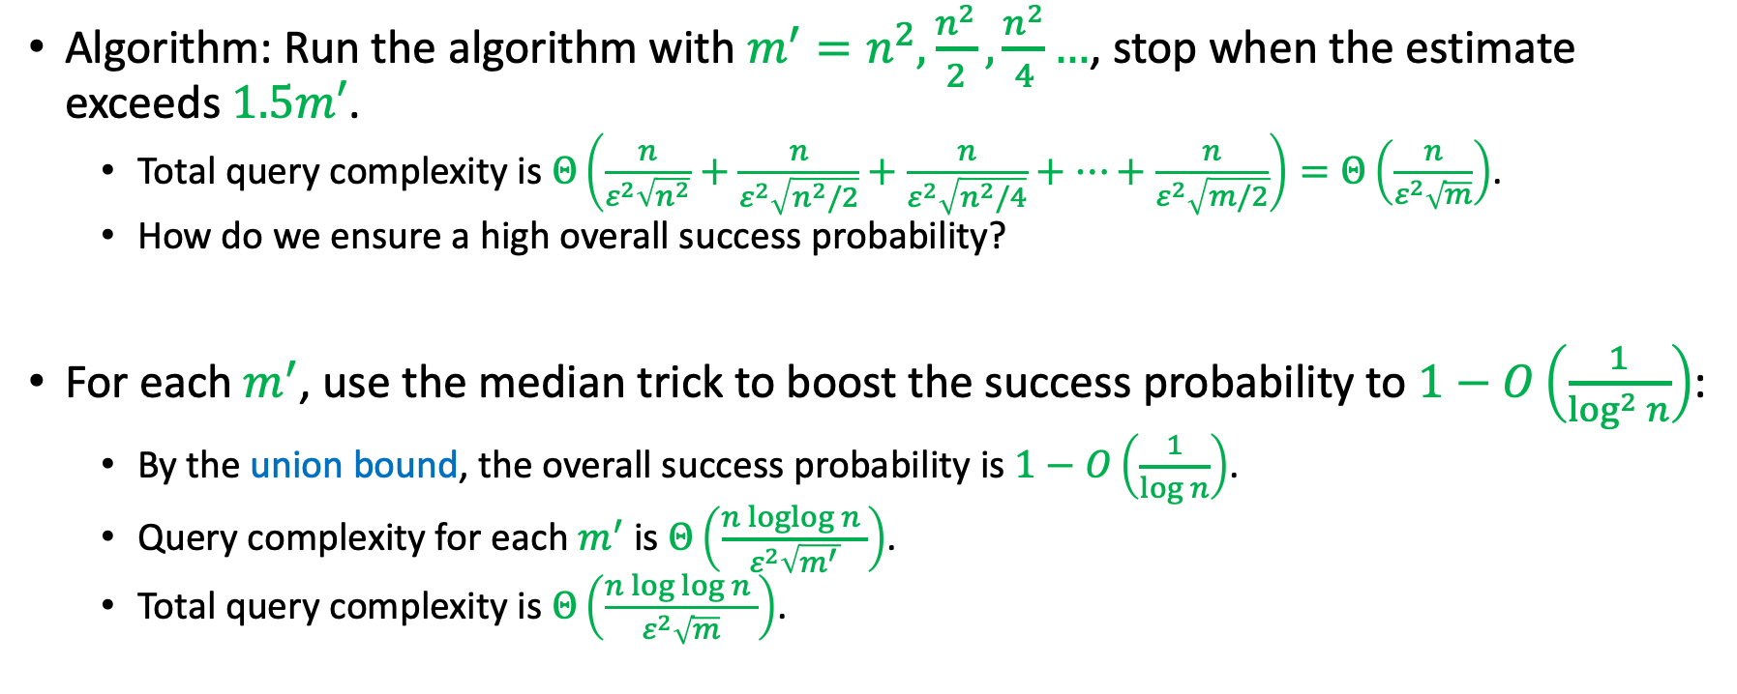
Guessing the Number of Edges
Algorithm: Run the algorithm with $m^{′}=n^{2},\frac{n^{2}}{2},\frac{n^{2}}{4}…$, stop when the estimate exceeds $1.5m′$.
Total query complexity is $Θ\left(\frac{n}{ε^{2}\sqrt{n^{2}}}+\frac{n}{ε^{2}\sqrt{n^{2}/2}}+\frac{n}{ε^{2}\sqrt{n^{2}/4}}+…+\frac{n}{ε^{2}\sqrt{m/2}}\right)=Θ\left(\frac{n}{ε^{2}\sqrt{m}}\right)$.
How do we ensure a high overall success probability?
For each $m^{′}$, use the median trick to boost the success probability to $1−O\left(\frac{1}{\log^{2}{n}}\right)$:
By the union bound, the overall success probability is $1−O\left(\frac{1}{\log{n}}\right)$.
Query complexity for each $m^{′}$ is $Θ\left(\frac{n\operatorname{loglog}{n} }{ε^{2}\sqrt{m^{′}}}\right)$.
Total query complexity is $Θ\left(\frac{n\log{\log{n}} }{ε^{2}\sqrt{m}}\right)$.

Slide 28
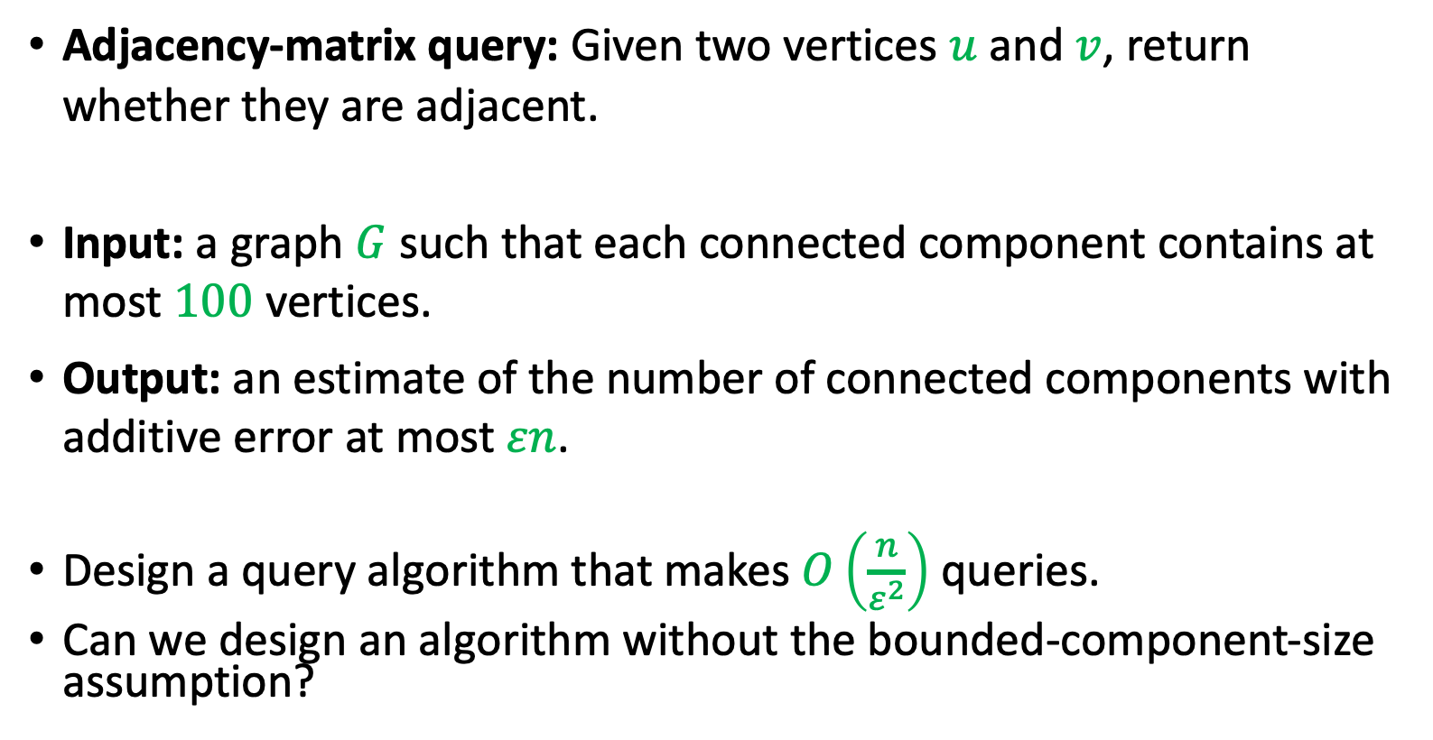
Take-Home Exercise: Number of Connected Components
Adjacency-matrix query: Given two vertices $u$ and $v$, return whether they are adjacent.
Input: a graph $G$ such that each connected component contains at most $100$ vertices.
Output: an estimate of the number of connected components with additive error at most $εn$.
Design a query algorithm that makes $O\left(\frac{n}{ε^{2}}\right)$ queries.
Can we design an algorithm without the bounded-component-size assumption?

